Slide 1
Introduction
OnBookStore
Supervisor:
MR. Le Thanh Nhan
Members:
Pham Quoc Chien
Nguyen Phuong Hoa
Truong Ngoc Minh Cat
Dang Hoang Quoc
Ho Anh Quan
25/04/2023

Slide 2
Content
Introduction
Actual requirements
Requirements of the project
Deployment diagram
Test result
Conclusion and development
Task list

Slide 3
Introduction - Actual requirements
OnBookStore is one of the business entities major in supplying a wide range of well-known books around the globe. Beloved customers can receive a diverse and rich collection of e-books, from many categories. We are committed to giving the best reading experience, fair price, and with the best customer service to all customer who want to have a miracle experience with our business.
As a high-standard service, we always find the best way to provide more services and special promotions for customer and create the unique which does not exist in any online commercial platform like our company.

Slide 4
Introduction - Requirements of the project
Functional
For user :
- Can register as a member and manage personal account. - Can search information of books. - Can view and buy books - Can give feedback, comment, rate about books. - Can view their orders.
Notes:
Non-functional (how the system works)
Functional (what the system should do)

Slide 5
Introduction - Requirements of the project
Functional
For admin:
- Can add / edit books - Can view customer’s information or deactivate an account. - Can view or edit all orders. - Can add / edit publisher. - Can view report statistics.
Notes:
Non-functional (how the system works)
Functional (what the system should do)

Slide 6
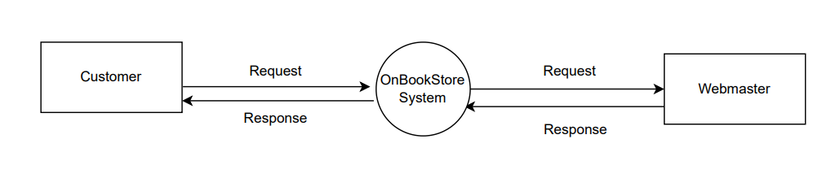
Introduction – Data flow diagram

Slide 7
Test Result [1]
Functional | Table use | Subject | Status
Login Register Edit account information | Customer | Customer | Done
Search product by name Filter product - Add to cart - Order product | book, Customer, Order (Order Master, Order Detail) | Customer | Done
View products liked View Order history | Book, Customer, Order | Customer | Done

Slide 8
Test Result [2]
Functional | Table use | Subject | Status
Login | Admin | Admin | Done
Book Management | Book | Admin | Done
Customer account Management | Customer | Admin | Done
Discount Management | Discount | Admin | Done
Feedback Management | Feedback | Admin | Done
Publisher Management | Publisher | Admin | Done

Slide 9
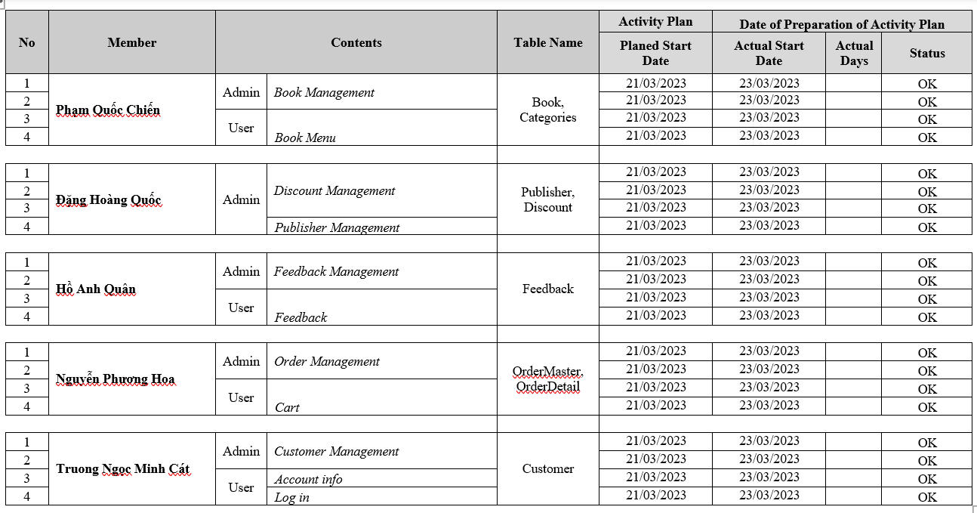
Task List

Slide 10

Thank You

Slide 11
Conclusion

Slide 12
Development

Slide 13
Reference

